Slide 1
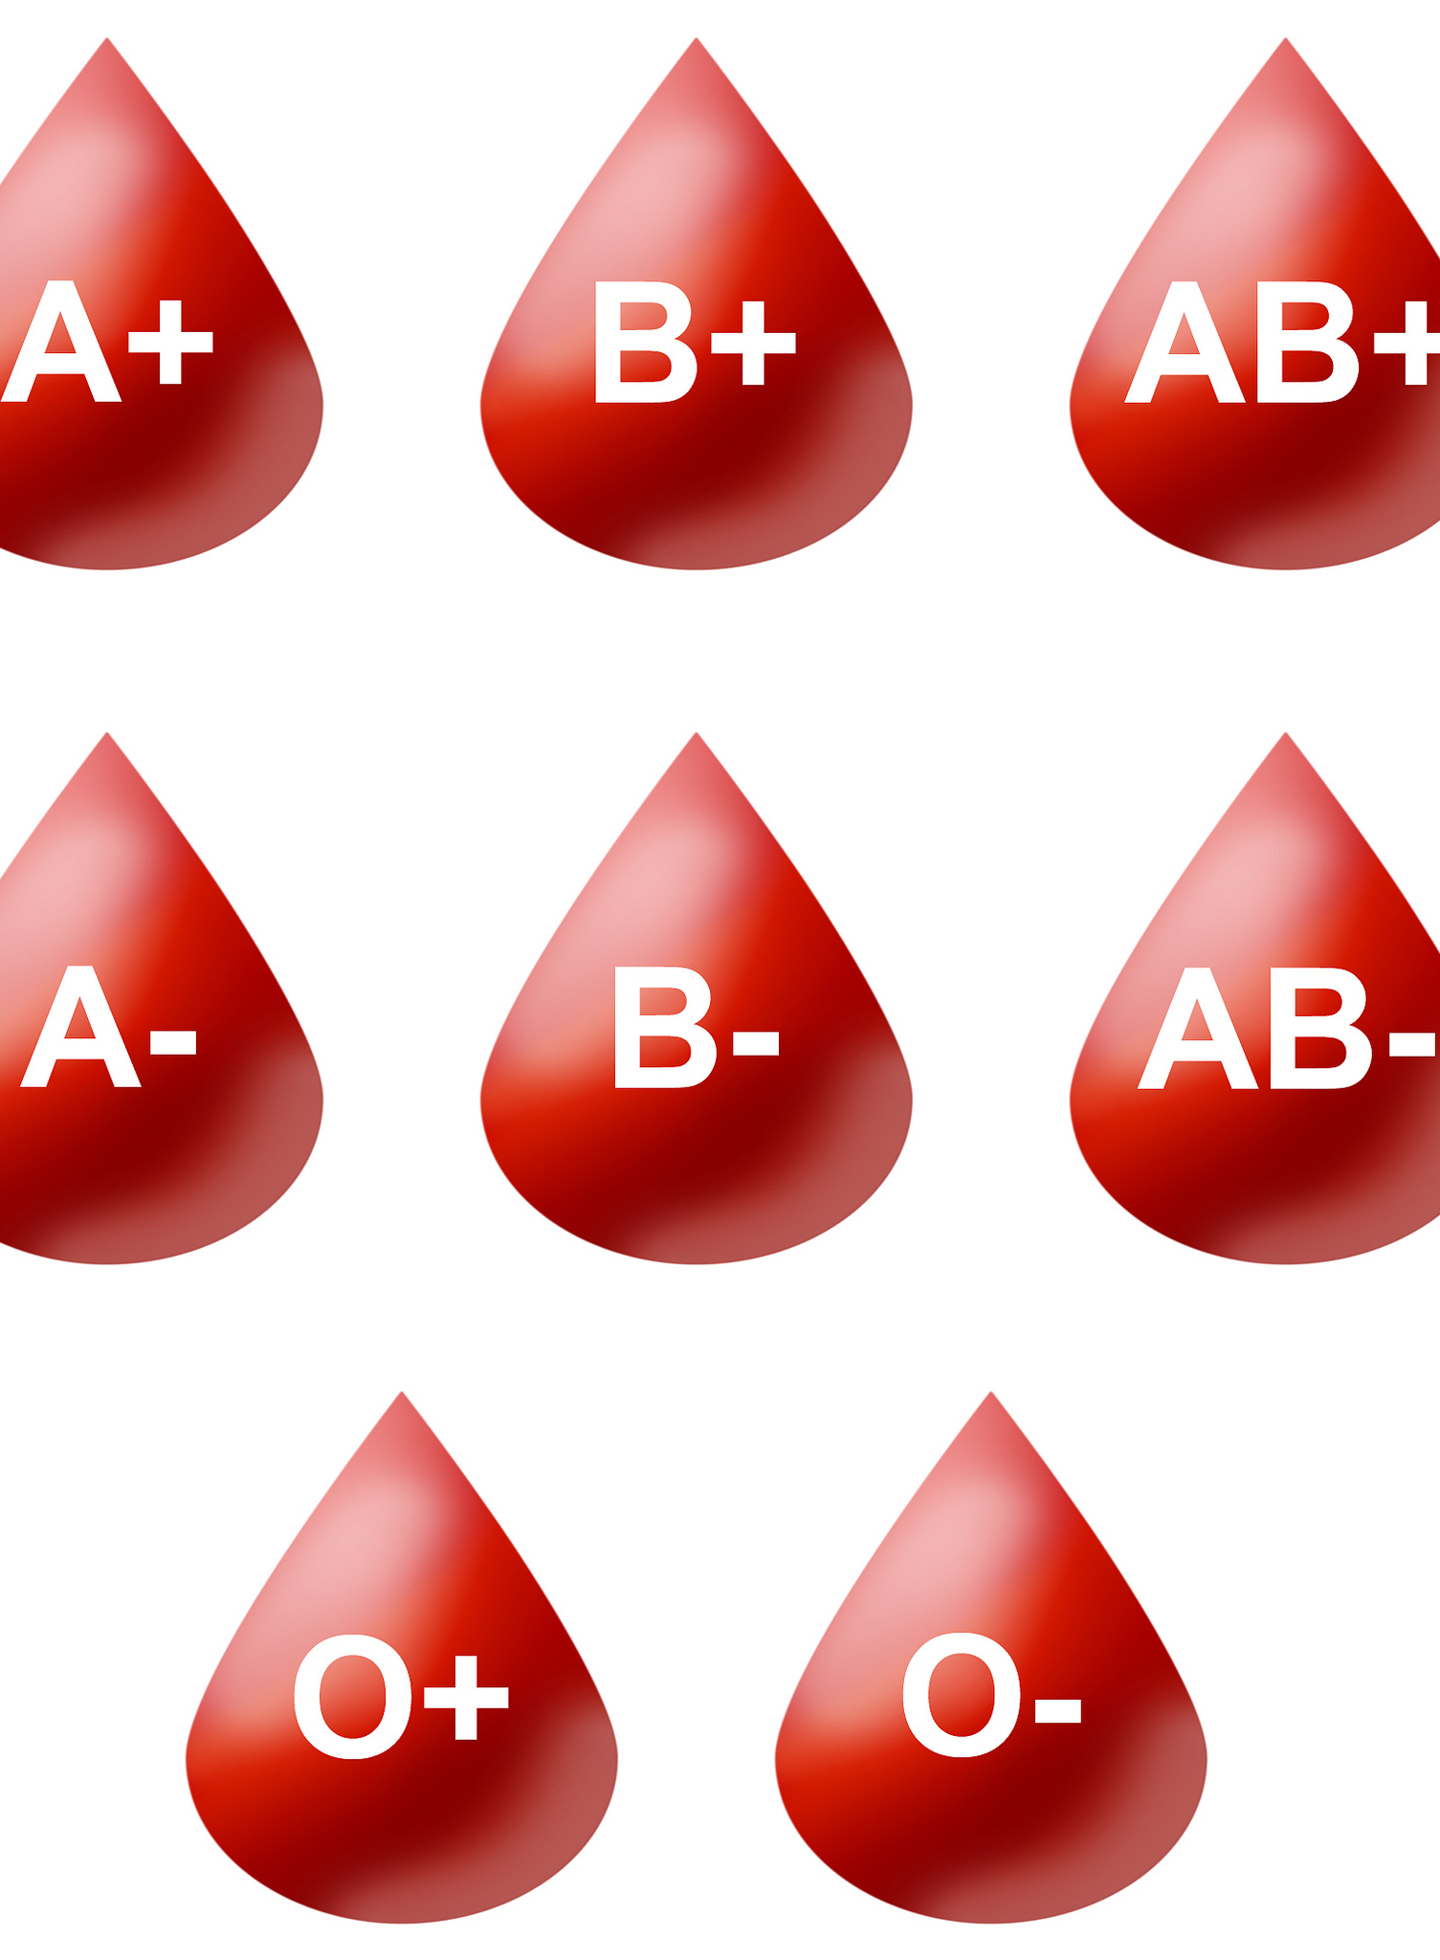
Blood Groups
AEHBY ATAR Human Biology

Slide 2
Review
Sketch a heart, showing (and labelling) the four chambers, septum, four valves and four main blood vessels.
List the components of blood (and %)
List four types of biomolecules (macromolecules) and for each name their monomer.

Slide 3
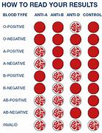
Learning Intentions
Blood transfusions rely on determining blood groups (ABO and Rhesus), and can be used to treat many different diseases and conditions

Slide 4
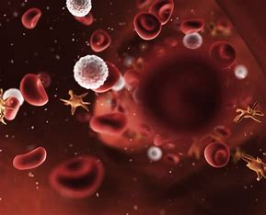
Success Criteria
Explain blood groups and rhesus factor groupings.
Define antibody and antigen

Slide 5
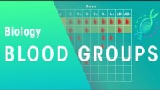

Slide 6
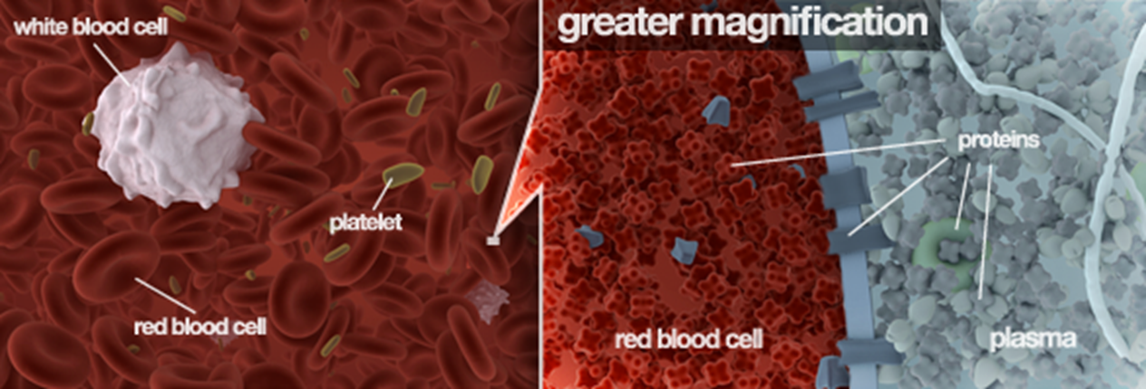

Slide 7
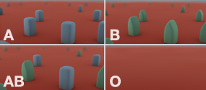

Slide 8
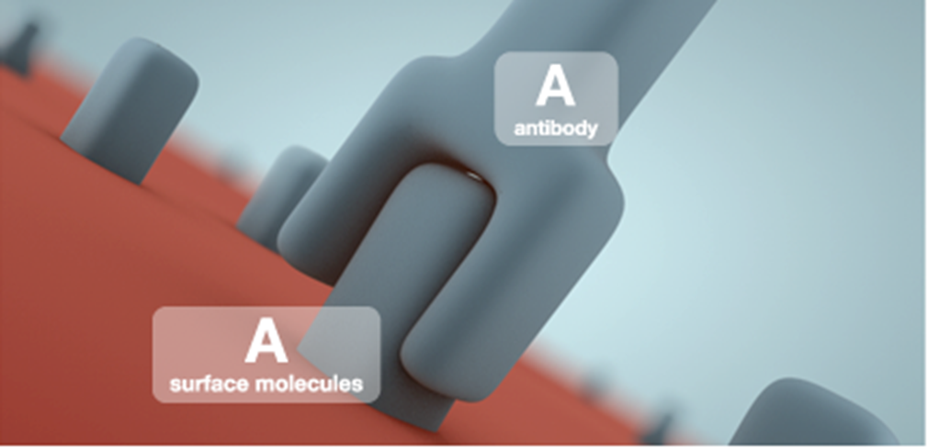

Slide 9
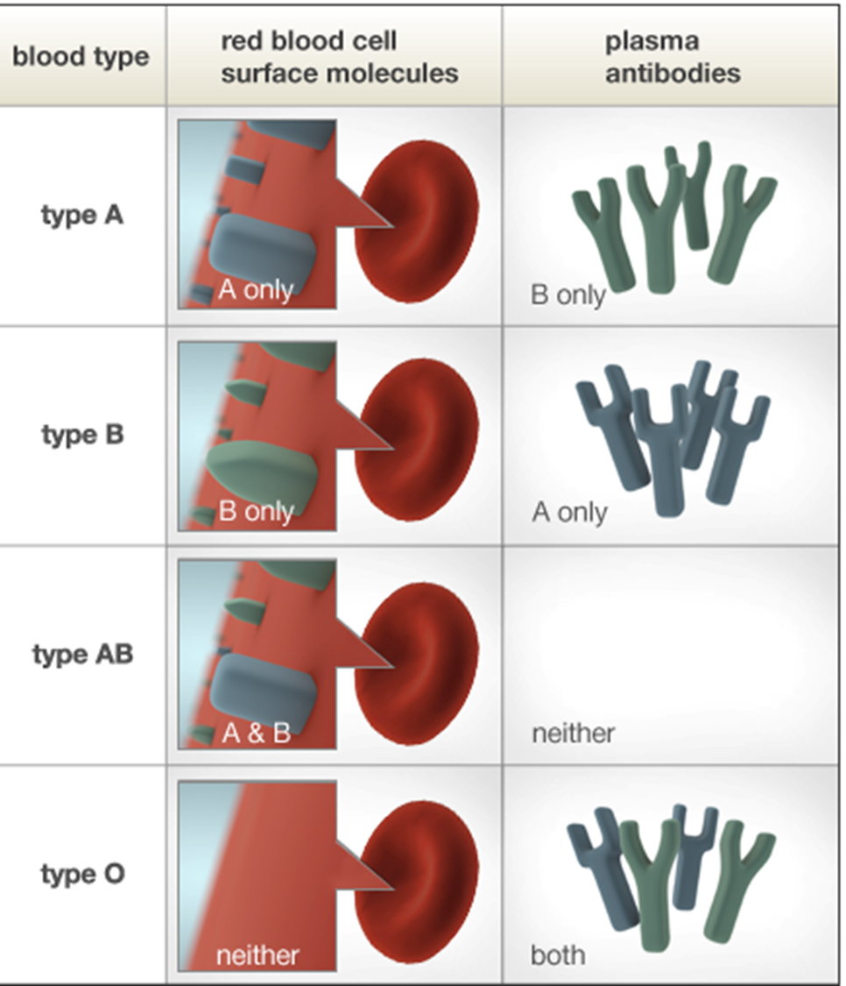

Slide 10
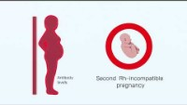

Slide 11
Success Criteria
Explain blood groups and rhesus factor groupings.
Define antibody and antigen

